Slide 1
SUCCESSION PLANNING
Anita Orozco, PhD

Slide 2
AGENDA
Why Bother with Succession Planning
Why is it important
What happens if we don’t do it
How does Succession differ from Replacement Planning
Develop the Plan
Job analysis
How to choose the right position
What to include
Manage the change
Execute the Plan
Responsibilities
Training, Mentoring and Selecting
Evaluate the Plan
Success metrics
Updating

Slide 3
What is Succession Planning
Identifying high potential employees, evaluating and improving their skills and abilities in order to prepare them for advancement
Into
Short-term or Long-term, business-critical positions

Slide 4
Long-term goals and objectives
Identify high-potential candidates
Development needs
Workforce trends and predictions

Slide 5
Avoid Costs
Extended vacancies, stability
Meaningful Opportunities
Target key leadership positions at varying levels
Diverse Workforce
Enables the decision-makers to look at the future of the organization

Slide 6
Succession Planning
Replacement Planning
Agile Workforce

Slide 7
DEVELOP THE PLAN
Key business priorities, goals and challenges
Key positions
Job analysis
People analysis
Tools
9 – box
Risk Assessment
Accept/Manage/Mitigate
Successor Assessment
365-degree feedback

Slide 8
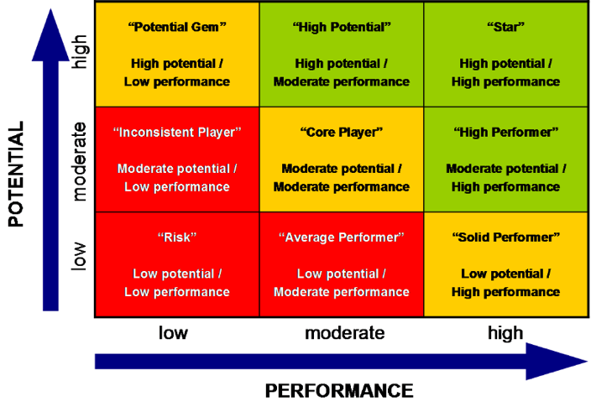

Slide 9
EXECUTE THE PLAN
Stay on Track
Stay Flexible
Stay Current

Slide 10
Metrics
Potential
Readiness
Risk of Loss
Impact of Loss
Performance

Slide 11
FINAL WORDS
What we covered
What we want to do for our organizations
Why it is important for our organizations
Questions

